Slide 1

Macro-Scale Network Measures and their Relation to Connectivity, Robustness, Resilience
Analyzing large-scale system properties and structural dynamics

Slide 2

Learning Objectives
Connectivity and Robustness
Understand how network connectivity impacts robustness and resilience to faults or attacks.
Structural and Centralization Measures
Interpret measures like components, diameter, and centralization to assess network topology and bias.
Real-World Network Applications
Apply concepts to communication, organizational, and infrastructure networks for practical understanding.

Slide 3
Connectivity, Robustness, and Resilience

Slide 4
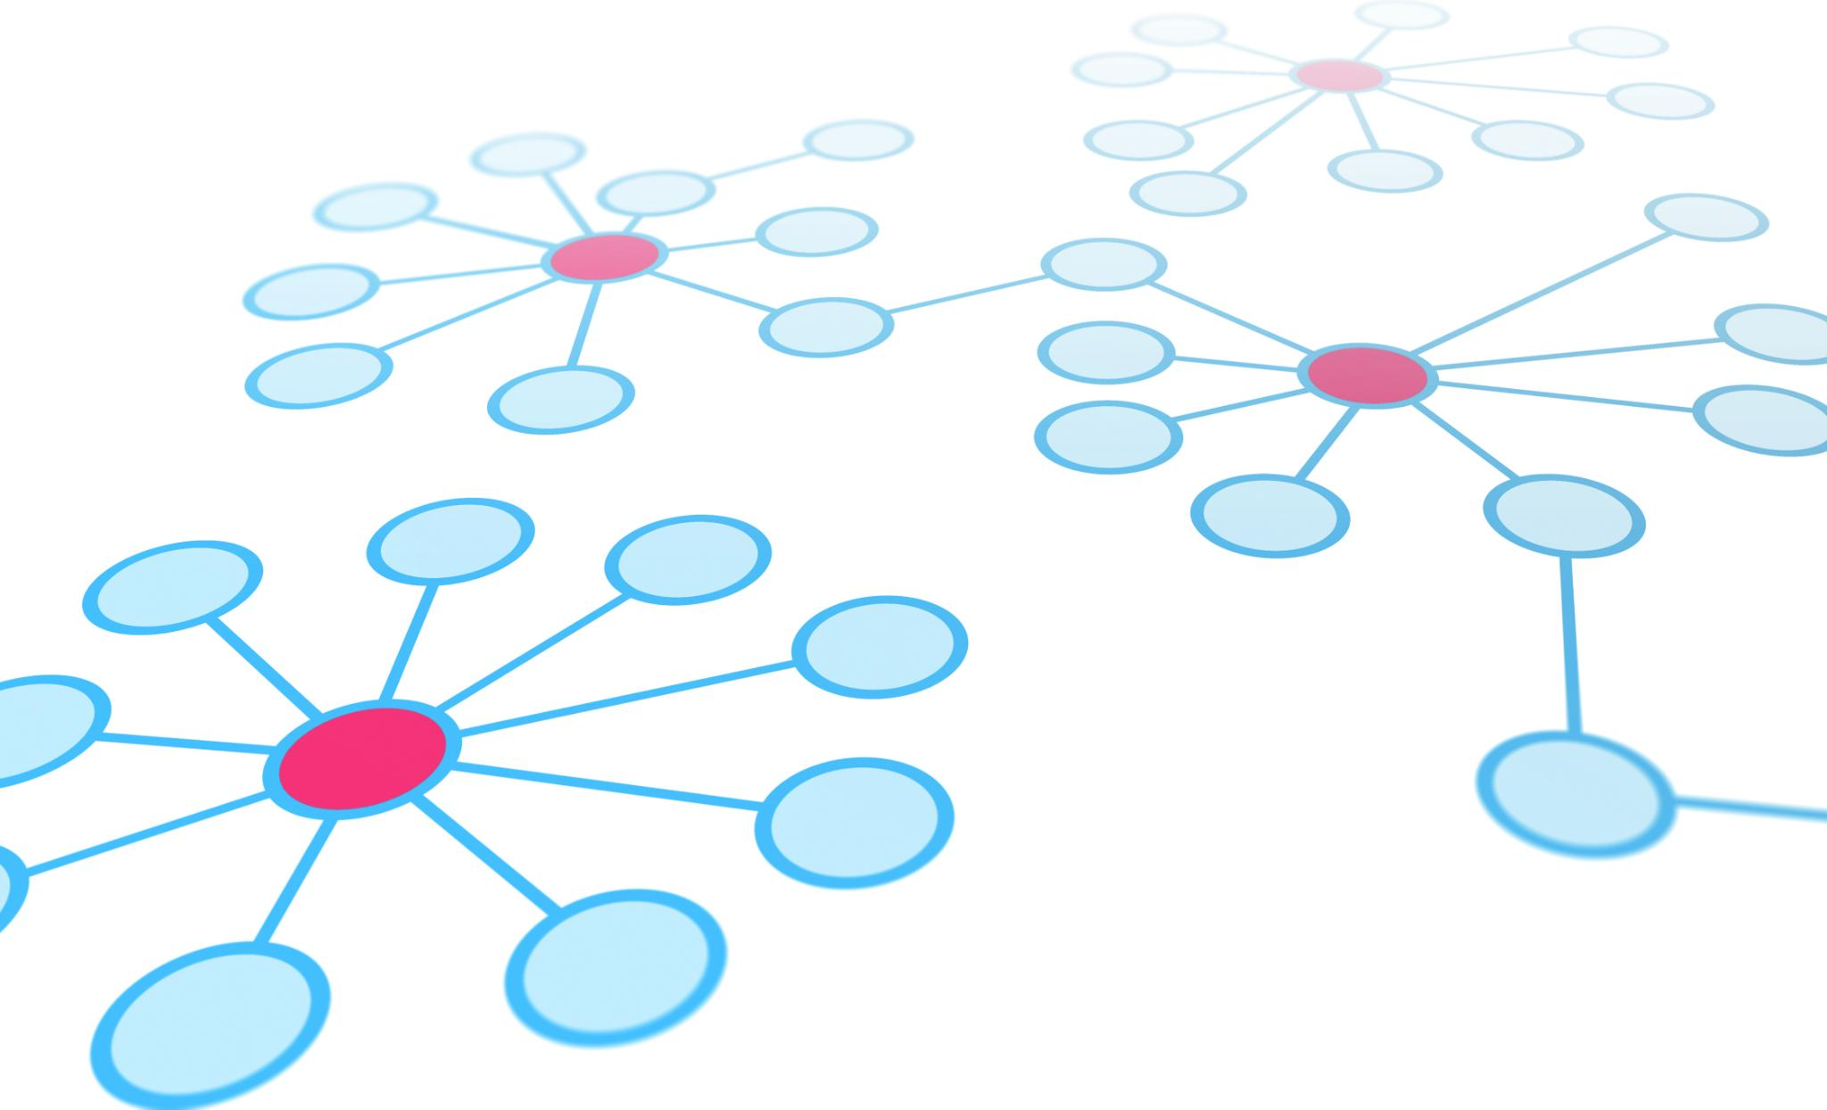
Conceptual Foundations
Network Connectivity
Connectivity is the ability of nodes to reach each other through paths, forming the network's backbone structure.
Robustness and Resilience
Robustness measures resistance to failures; resilience is the network's ability to restore function after disruptions.
Trade-offs in Design
Redundancy improves fault tolerance but may increase costs; design must balance these factors.
Percolation Theory
Percolation theory explains giant component existence during node or edge removal in real-world systems.

Slide 5
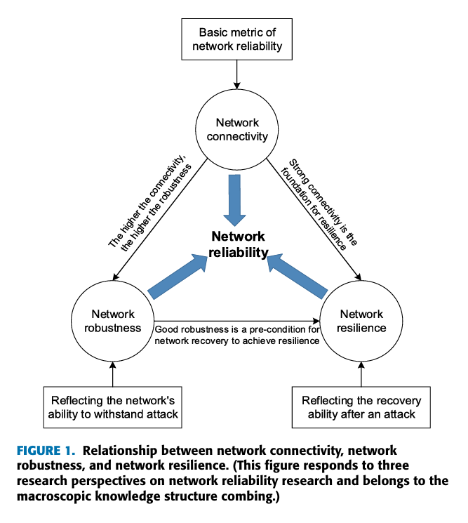
J. Xu and D. J. Nair, "Data-Driven Network Connectivity Analysis: An Underestimated Metric," in IEEE Access, vol. 12, pp. 60908-60927, 2024, doi: 10.1109/ACCESS.2024.3393968.

Slide 6

Structural Robustness and Vulnerability of Networks.
Schwarze, A. C., Jiang, J., Wray, J., & Porter, M. A. (2024). Structural Robustness and Vulnerability of Networks. arXiv [Physics.Soc-Ph]. Retrieved from http://arxiv.org/abs/2409.07498

Slide 7
Network Attack Surface -Nodes
Strategies:
Random or Targeting of hubs, betweenness, eigenvector, articulation, etc… Adaptive/iterative targeting.
Structural Attacks
Node removal
Node disability
Node relation
Node Substitution
Node Addition
Functional Attacks
Node infection/compromise
Node capacity reduction
Node overload
Node misreporting
Node jamming or interference

Slide 8
Network Attack Surface -Edges
Strategies:
Random or Targeting betweenness, bridges, minimum conductance cuts, inter-community edges, shortest path cuts.
Structural Attacks
Edge removal
Edge addition
Edge rewiring
Edge suppression
Edge duplication/shadowing
Functional Attacks
Edge throttling/rate limiting
Edge degradation
Edge overload
Edge capacity expansion
Edge direction swap
Edge poisoning

Slide 9
Topology‑Level & Higher‑Order Attacks
Topology Alteration Attacks Global rewiring (destroys clustering or small‑world structure) Modularity disruption (break communities or artificially intensify them) Geometry distortion (in spatial networks) Multilayer attack propagation (remove dependencies in interdependent networks) Flow‑Level or Functional Attacks Denial‑of‑Service at cut bottlenecks (conductance‑relevant) Cascade initiation (trigger load redistribution cascades) Routing manipulation (force traffic through fragile parts) Diffusion sabotage (slow or redirect diffusion processes) Data / Information Attacks (important for algorithmic networks) Graph poisoning attacks (on GNNs or community detection) Graph inference attacks (privacy leakage, structural reconstruction) Contagion seeding strategies (high‑degree vs high‑k‑core seeding)

Slide 10
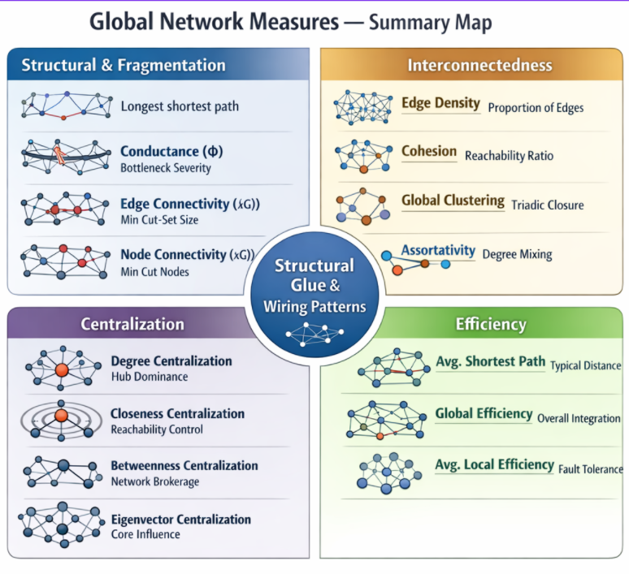
Created with Microsoft Copilot: 2026

Slide 11
Structural and Fragmentation Measures

Slide 12
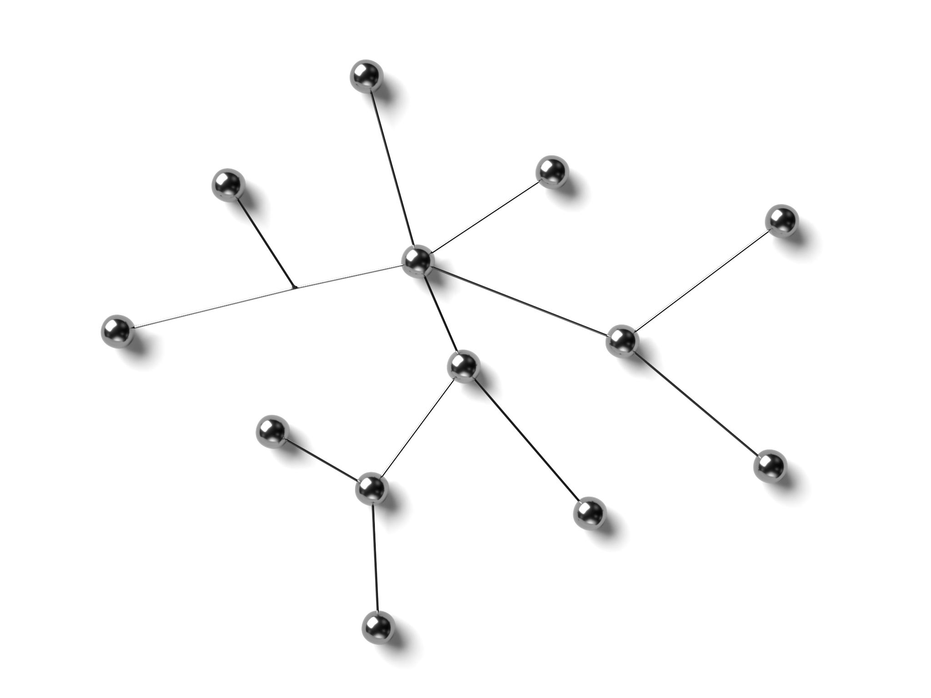
Components and Isolates
Definition of Components
Components are maximal sets of nodes mutually reachable in a network, showing connectivity structure.
Types of Components
Undirected networks have connected components, while directed networks have strong and weak components.
Role of Isolates
Isolates are nodes with zero connections, indicating disengagement or possible incomplete data in networks.
Impact on Network Health
High numbers of components and isolates reduce connectivity, hindering information flow and collaboration.

Slide 13
Structure and Fragmentation
Diameter
Longest geodesic. Establishes the network’s “worst‑case” reachability horizon; sensitive to outliers and fragmentation.
Conductance (Φ) / Expansion
Bottleneck strength across a cut. Low Φ exposes sparse inter‑community ties (easy to fragment), high Φ indicates well‑mixed structure.
Adhesion (Edge‑Connectivity, λ(G))
Minimum edges to disconnect. Operational robustness of links; complements conductance with an exact cut threshold.
Node Connectivity (κ(G))
Minimum nodes to disconnect. Single‑point‑of‑failure exposure at the node level; pairs naturally with λ(G); teach κ(G) ≤ λ(G) ≤ δ(G).
Algebraic Connectivity (λ₂ of Laplacian)
Spectral cohesion. A single scalar that rises with tighter global “glue,” faster synchronization, and resistance to fragmentation.

Slide 14
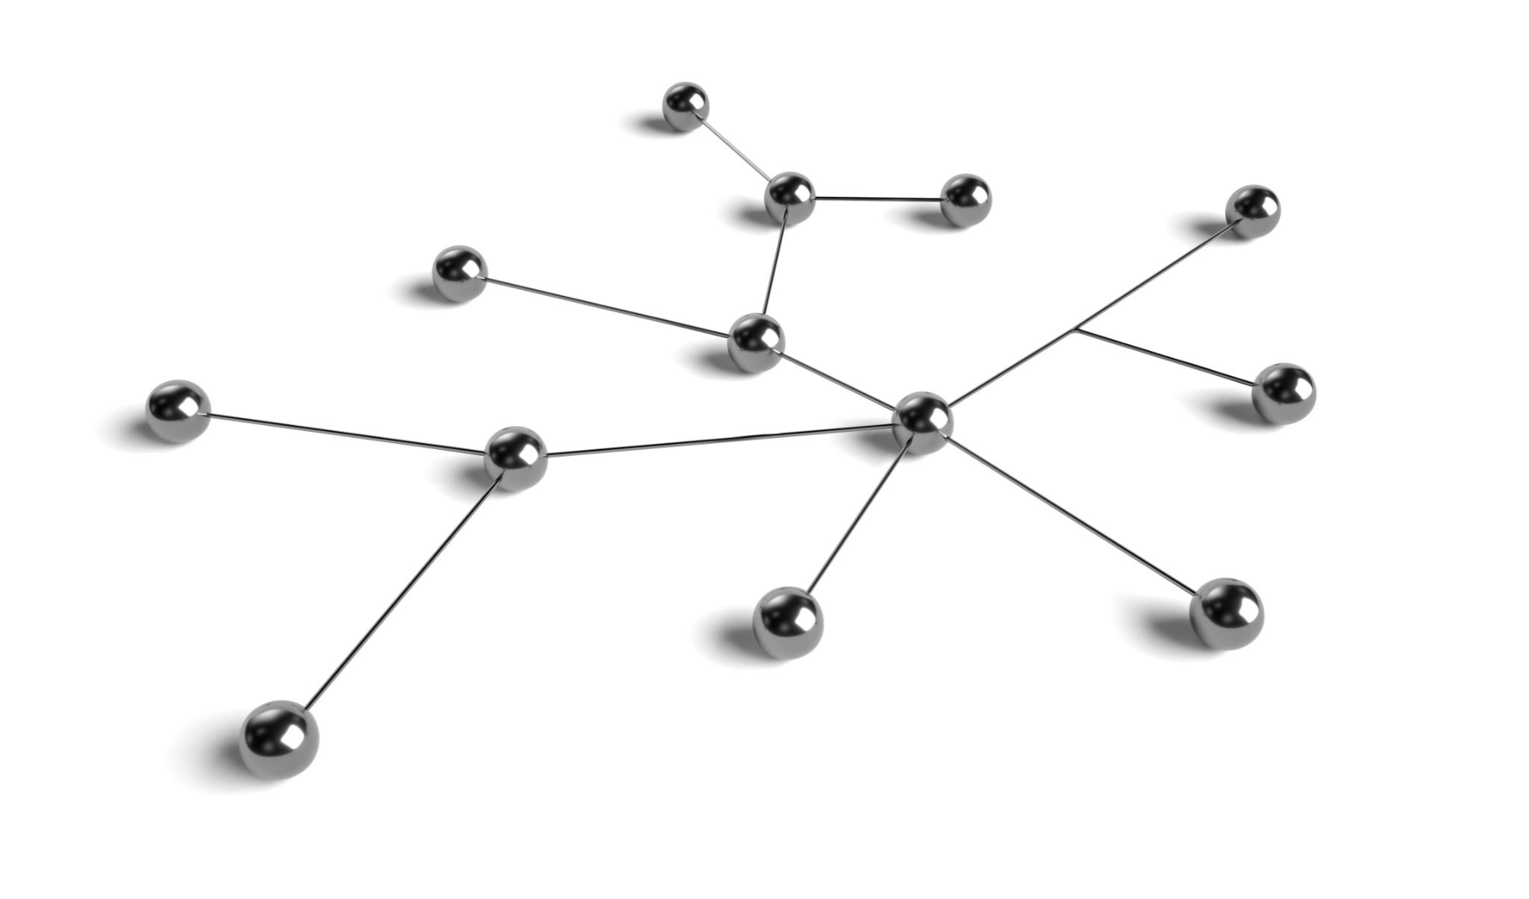
Bridges and Articulation Points
Definition of Bridges
Bridges are edges which, if removed, increase the number of disconnected components in a network.
Definition of Articulation Points
Articulation points are nodes whose removal fragments the network into separate parts.
Importance in Network Resilience
Identifying bridges and articulation points helps design resilient systems by addressing single points of failure.
Real-world Network Examples
In communication and social networks, articulation points represent key routers or influential individuals linking communities.

Slide 15
Diameter
WHAT it Measures
Diameter is the maximum shortest‑path distance observed between any two reachable nodes in the network (i.e., the maximum of node eccentricities).
Conventions you must state explicitly (they change the value/meaning):
Disconnected graphs: diameter is often taken as ∞; in practice, many report diameter on the giant component or ignore ∞ pairs.
Directed graphs: use strong diameter (within strongly connected components) or weak/undirected diameter (on the symmetrized graph).
Weighted graphs: compute using cost/length weights; the “distance” is the minimal total edge weight, not hop count.
WHY
Diameter provides a hard upper bound on geodesic travel time/steps in the network—if interactions prefer shortest paths, no pair takes longer than the diameter to connect. This is a measure of extreme structural stretch and is highly senstive to outliers (thin bridges/long chains) and higlights where adding a single well‑placed shortcut can be helpful.
WHEN to Use Diameter
Use diameter when your question is intrinsically worst‑case (service guarantees, SLAs, deadlines, safety margins):
Emergency response / alerting: maximum hops to reach the last recipient.
Supervisory control: bound on approval/authorization chains.
Transport/logistics: upper‑bound transfers when hop count approximates cost.
Testing structural change: does a rewire eliminate long tails?

Slide 16
Diameter
Use caution or alternatives when:
The graph is fragmented (diameter = ∞ is uninformative) → report giant‑component diameter and pair with cohesion/efficiency.
Average behavior matters more than extremes → prefer Average Shortest Path Length.
You need a robust “near worst‑case” → consider effective diameter (e.g., 90th‑percentile shortest‑path length) to reduce sensitivity to outliers
Pairing: interpret diameter alongside other measures in order to properly represent speed, bottlenecks, and resilience. It's not a very representative or interpretable measure alone.
Connectivity
In a connected network, diameter separates “connected and tight” from “connected but stretched”.
In a disconnected network, raw diameter is meaningless (∞); report component‑restricted diameter and pair with cohesion to reflect reachability coverage.
Robustness (resistance to failure)
If small diameter is driven by few critical shortcuts/hubs, targeted removal can inflate diameter sharply or split the network—revealing latent fragility.
If small diameter is produced by multiple distributed shortcuts, targeted failures increase the diameter more gradually.
Resilience (recovery/continuity)
Resilient architectures maintain bounded (or quickly re‑bounded) diameter under perturbation via alternative long‑range paths.
Recovery strategies that recreate a few well‑placed cross‑module links can restore diameter efficiently without wholesale rewiring.

Slide 17
Diameter
Example Use Cases:
Leskovec, J., Kleinberg, J., & Faloutsos, C. (2007). Graph Evolution: Densification and Shrinking Diameters. arXiv [Physics.Soc-Ph]. Retrieved from http://arxiv.org/abs/physics/0603229

Slide 18
Conductance (Φ) / Expansion
WHAT it Measures
Conductance quantifies the strength of the weakest “bottleneck” cut in a network.
For a subset of nodes S (nonempty, not all of V), conductance compares the size of the edge boundary between S and its complement \bar S to the volume (total incident degree/weight) of the smaller side.
The graph’s conductance Φ(G) (a Cheeger‑type constant) is the minimum conductance over all balanced cuts.
Intuition: a small Φ(G) means there exists a thin “neck(s)”—few inter‑group edges relative to the interior edges—so flow/information mixes poorly across that divide; a large Φ(G) means the network is well‑knit with no easy place to sever it proportionally.
Notes
Undirected, unweighted graphs: boundary = number of edges crossing the cut; volume = sum of degrees on the side.
Weighted graphs: replace counts with weights (capacities, costs).
Directed / Markov‑chain conductance: defined using the stationary distribution
WHY
Conductance formalizes how easily the network can be “pinched” into two parts. It is a ratio measure: not just “how many cross edges,” but how many cross edges relative to how many edges are inside each side.
NOTE: two parts does NOT mean that each side is connected. This is a set S and it’s complement S’ not necessarily two connected sets.
It is tightly connected to mixing of random walks and diffusion: higher conductance → faster mixing, lower conductance → slow mixing / poor inter‑module exchange.

Slide 19
Conductance (Φ) / Expansion
WHEN to Use Conductance
Use conductance when your questions involve bottlenecks, mixing, or cut strength:
Robustness analysis: Identify whether there exists a vulnerable partition whose boundary is sparse relative to its interior (a likely point of failure or isolation).
Community detection evaluation: Score how “well separated” a proposed community is (low conductance communities are internally tight, externally sparse).
Containment: Understand whether module boundaries naturally slow cross‑module spread.
Performance modeling: Anticipate latency or load concentration where cuts are thin.
Caveats
Optimization: finding the minimum‑conductance cut exactly is computationally hard; use spectral partitioning or flow‑based approximations.
Scale and balance: most definitions restrict to reasonably balanced subsets (e.g., volume constraints).
INTERPRETATION (High vs Low)
Low Conductance (Φ small)
There exists a sparse boundary relative to interior volume ⇒ clear bottleneck.
Slow mixing across this boundary (walks and information linger within modules).
Subtleties
A network can be dense yet have low conductance if most edges are intra‑module and only a few are cross‑module.
Conversely, sparse but well‑spread wiring can produce higher conductance than a dense but highly clustered network.

Slide 20
Conductance (Φ) / Expansion
RELATIONSHIP to Connectivity, Robustness, and Resilience
Connectivity
Low conductance identifies structural bottlenecks that still exist even when the graph is connected; it explains where connectivity is geometrically fragile.
High conductance means no cheaply isolatable side—connectivity is uniformly “sticky” across the graph.
Robustness (Resistance to Failure)
Targeted removal of boundary edges in a low‑conductance cut can separate the network or severely reduce cross‑module reach.
In high‑conductance graphs, proportionally many edges must be removed to achieve similar damage, implying greater edge‑level robustness.
Resilience (Recovery/Continuity)
Systems with low conductance require adding cross‑module edges (or reweighting) to recover flow; a few well‑placed bridges can dramatically increase Φ.
High‑conductance structures degrade gracefully and recover quickly since many parallel corridors exist; restoring any subset of them rapidly re‑establishes mixing.

Slide 21
Conductance (Φ) / Expansion
Examples:
van Laarhoven, T., & Marchiori, E. (2016). Local Network Community Detection with Continuous Optimization of Conductance and Weighted Kernel K-Means. arXiv [Cs.SI]. Retrieved from http://arxiv.org/abs/1601.05775
Yang, Y., Wang, M., Bindel, D., & He, K. (2021). Streaming Local Community Detection through Approximate Conductance. arXiv [Cs.SI]. Retrieved from http://arxiv.org/abs/2110.14972

Slide 22
Adhesion (Edge Connectivity) λ(G)
WHAT it Measures
Adhesion (edge‑connectivity), λ(G) is the minimum number of edges whose removal disconnects the graph (i.e., increases the number of connected components). (Min-cut-set is the set of these edges)
Weighted graphs: replace “number of edges” with minimum total capacity of edges whose removal disconnects the graph.
Directed graphs: analogous notions use arcs and may target strong connectivity (minimum arcs to destroy strong connectivity) or s–t connectivity (minimum arcs to disconnect a specific pair).
WHY it Matters
λ(G) is a hard, adversarial threshold for link failures: it tells you the smallest attack budget in edges that can break the network.
By duality with edge‑disjoint paths, λ(G) measures how many parallel corridors exist in the most vulnerable location; this is the structural backbone of rerouting.
WHEN to Use Adhesion
Use λ(G) when you need a cut‑set robustness guarantee or to locate true structural weak points:
Safety‑critical infrastructures (power, transport, backbone links): minimum edges to isolate a region.
Organizational & process networks: minimum approvals/links whose loss halts inter‑unit coordination.
Security/Red‑team analysis: smallest set of cross‑module links to remove or protect.
Resilience design: set targets (e.g., “ensure λ(G) ≥ k across critical partitions”).

Slide 23
Adhesion (Edge Connectivity) λ(G)
INTERPRETATION (High vs Low)
Low λ(G)
Easy to sever: few edges form a cut whose removal disconnects the network.
λ(G)=0 ⇒ already disconnected.
λ(G)=1 ⇒ there exists a bridge (single edge whose removal disconnects the graph).
Often indicates module interfaces supported by very few boundary edges (even if modules are dense internally).
Notes
κ(G) ≤ λ(G) ≤ δ(G)
Node‑connectivity ≤ edge‑connectivity ≤ minimum degree.
Reading: to disconnect, you can’t need fewer nodes than edges, and you can’t require more edges than the least degree available.
Two‑edge‑connected graphs have λ(G) ≥ 2 (no single bridge).
Note the distinction from conductance: λ(G) is an absolute cut size, while conductance is a ratio (boundary/volume) tied to mixing and balanced partitions.

Slide 24
Adhesion (Edge Connectivity) λ(G)
RELATIONSHIP to Connectivity, Robustness, and Resilience
Connectivity
λ(G) measures distance to disconnection in edge units: how many edges must fail (in the best‑chosen place) before connectivity breaks.
Complements binary connectivity with a quantitative margin.
Robustness (Resistance to Failure)
Adversarial failures: λ(G) is the guarantee—fewer than λ(G) targeted edge removals cannot disconnect the network.
Random failures: λ(G) alone does not predict percolation thresholds, but small λ(G) flags likely thin interfaces where random breaks can cause disproportionate damage.
Resilience (Recovery/Continuity)
High λ(G) implies multiple edge‑disjoint fallback routes → fast rerouting and graceful degradation.
Raising λ(G) typically requires creating independent cross‑module links (not just reinforcing a single corridor), which improves post‑failure continuity without centralized bottlenecks.

Slide 25
Adhesion (Edge Connectivity) λ(G)
Examples:
Biswas, R. S., Pal, A., Werho, T., & Vittal, V. (2021). A Graph Theoretic Approach to Power System Vulnerability Identification. IEEE Transactions on Power Systems, 36(2), 923–935. doi:10.1109/tpwrs.2020.3010476 https://arxiv.org/abs/2007.07859
Article Source: A deterministic approach for rapid identification of the critical links in networks
Vodák R, Bíl M, Svoboda T, Křivánková Z, Kubeček J, et al. (2019) A deterministic approach for rapid identification of the critical links in networks. PLOS ONE 14(7): e0219658. https://doi.org/10.1371/journal.pone.0219658

Slide 26
Node Connectivity (κ(G))
WHAT it Measures
Node Connectivity, denoted κ(G), is the minimum number of vertices whose removal disconnects the network.
This is a strict, graph‑theoretic measure of the vertex‑cut size of the network.
κ(G) formalizes: “How many nodes must fail (or be attacked) before the network is guaranteed to break apart?”
Menger’s Theorem (vertex version):
κ(G) equals the maximum number of internally vertex‑disjoint paths between the two “most weakly connected” nodes in the graph.
Intuition: κ(G) counts how many redundant node‑independent corridors exist at the most vulnerable location.
Modeling notes
For directed graphs: vertex connectivity requires choosing a definition of connectivity (weak vs strong).
WHY it Matters
κ(G) is the vertex‑level analogue of edge‑connectivity λ(G), capturing failure tolerance of nodes, which is often more realistic in communication, infrastructure, and organizational systems (nodes fail more often than edges).
κ(G) identifies single points of failure (κ(G)=1) and choke‑actor roles whose removal fragments the system.
The relationship between κ(G) and vertex‑disjoint paths gives it direct relevance for redundant routing, load balancing, and parallelism in the underlying structure.

Slide 27
Node Connectivity (κ(G))
WHEN to Use Node Connectivity
Node connectivity is essential when your focus is node‑level failures or actor removal scenarios:
Organizational networks: To identify how many key individuals must be lost before communication ruptures between groups.
Infrastructure networks: Power substations, routers, servers—nodes are often failure points.
Security / adversarial analysis: Minimum number of strategically chosen nodes to compromise to partition a system.
Resilient design: Set structural goals like “ensure κ(G) ≥ 3 for critical modules.”
Fault‑tolerant routing: Systems requiring multiple independent routing paths through distinct nodes.
Modeling cautions
κ(G) is expensive to compute exactly for large graphs (requires repeated min‑cut computations with node splitting), but practical algorithms and heuristics exist.
Key inequality
κ(G) ≤ λ(G) ≤ δ(G)
Node connectivity ≤ edge connectivity ≤ minimum degree.
Provides upper bounds and allows consistency checks for student solutions.
Subtleties
High κ(G) does not guarantee short paths or high efficiency—it only guarantees multiple internally disjoint alternatives.
High λ(G) (edge‑connectivity) does not guarantee high κ(G); adding many edges incident to the same node increases λ(G) but not κ(G).

Slide 28
Node Connectivity (κ(G))
RELATIONSHIP to Connectivity, Robustness, and Resilience
Connectivity
κ(G) gives a quantitative buffer against node failures beyond binary connected/disconnected status.
It is a hard guarantee: fewer than κ(G) node removals cannot disconnect the network no matter where they occur.
Robustness (Resistance to Failure)
κ(G) directly measures node‑robustness: the minimum number of nodes whose failure leads to fragmentation.
If failures are random, κ(G) alone is insufficient; you pair it with degree distribution, assortativity, and local efficiency.
If failures are targeted, κ(G) is extremely informative—systems with κ(G)=1 or 2 are trivially compromised by targeted removal of central actors.
Resilience (Recovery / Continuity)
High κ(G) supports graceful degradation: losing one or several nodes does not impede communication between major regions.
Recovery from node failures is faster because alternative node‑independent corridors exist to reroute information.
In low‑κ(G) networks, recovery often requires adding new nodes or adding ties between neighbors of cut‑vertices.

Slide 29
Node Connectivity (κ(G))
Examples:

Slide 30
Algebraic Connectivity (Fiedler Value λ₂)
WHAT it Measures
Algebraic connectivity is the second-smallest eigenvalue of the (combinatorial) Laplacian L=D−A of an undirected graph. It is often denoted λ2 and called the Fiedler value.
Connectivity criterion: λ2>0 iff the graph is connected; λ2 =0 with multiplicity equal to the number of connected components.
Normalized variant: For the normalized Laplacian \mathcal{L} = I - D^{-1/2} A D^{-1/2}, the analogous quantity is the second-smallest eigenvalue \lambda_2(\mathcal{L})\in[0,2] (sometimes called the spectral gap).
WHY it Matters
λ2 is a global cohesion knob: it increases when the graph becomes harder to separate and decreases when a bottleneck or thin bridge emerges.
It governs dynamic performance on networks:
Synchronization/consensus speeds (e.g., linear consensus, Laplacian dynamics) are faster for larger λ2 .
Random‑walk mixing and diffusion relate to the spectral gap (for \mathcal{L} or the random‑walk matrix).
Unlike purely combinatorial counts (e.g., density), λ2 captures how edges are placed with respect to global cohesion and not just how many there are.
WHEN to Use Algebraic Connectivity
Robustness design & auditing: ensure the network maintains a minimum spectral cohesion threshold; diagnose where small cuts would substantially reduce λ2 .
Large‑scale summarization: when you need a single scalar that reflects “how well‑glued” the network is, integrating both density and placement of cross‑links.

Slide 31
Algebraic Connectivity (Fiedler Value λ₂)
Caveats
Value depends on edge weights and degree heterogeneity
For directed graphs, Laplacian spectra are more delicate; use symmetrized or directed Laplacians with care when interpreting “algebraic connectivity.”
High λ2 does not imply short average distance; it implies cohesive connectivity, which is different from geodesic speed.
INTERPRETATION (High vs Low)
High λ2
The graph is spectrally well‑knit: no balanced cut has a very thin boundary; mixing and consensus are fast; synchronization is easier.
Multiple, well‑distributed cross‑links exist between regions; removing a few edges rarely isolates a large part of the network.
The Fiedler vector varies smoothly—no sharp sign split—signaling the absence of a dominant bottleneck.
Low λ2 (but > 0)
The graph is connected but nearly decomposable: a sparse inter‑module interface or long thin corridor slows mixing and consensus.
The Fiedler vector typically exhibits a sign (or magnitude) split that pinpoints the weak interface; small changes there produce large spectral effects.
A few additional bridging edges across that interface can substantially increase λ2 .

Slide 32
Algebraic Connectivity (Fiedler Value λ₂)
RELATIONSHIP to Connectivity, Robustness, and Resilience
Connectivity
Threshold property: λ2 >0 ⇔ connected.
Magnitude property: larger λ2 ⇒ stronger global connectivity in an isoperimetric sense (fewer, thicker cuts).
Robustness (Resistance to Failure)
λ2 upper‑ and lower‑bounds relate to conductance Φ; low λ2 flags easily isolatable balanced regions.
Targeted removal of edges/nodes along the Fiedler cut rapidly decreases λ2 , revealing spectral weak spots even in dense graphs.
Compared to λ(G) (edge‑connectivity) or κ(G) (node‑connectivity), λ2 is a soft, global surrogate: it does not count minimal cut sizes, but it captures how broadly the graph resists separation.
Resilience (Recovery/Continuity)
Recovery strategies that add a few cross‑module edges across the Fiedler cut disproportionately increase λ2 and restore mixing/consensus performance.
Networks with larger λ2 exhibit graceful degradation under distributed failures: many alternative “energy‑spreading” routes exist.

Slide 33
Algebraic Connectivity (Fiedler Value λ₂)
Examples:

Slide 34
Interconnectedness Measures

Slide 35

Density, Cohesion, Clustering, and Assortativity
Density of Network
Density represents the fraction of existing ties out of all possible connections, measuring network interconnectedness.
Network Cohesion
Cohesion indicates the proportion of reachable node pairs, reflecting how integrated the network is overall.
Global Clustering Coefficient (Transitivity)
Triangle prevalence. Local redundancy/closure; strongly influences local robustness and diffusion micro-dynamics.
Assortativity
Wo connects to whom by degre. Assortative (hub-hub) versus disassortative (hub-leaf) structures with implications for epidemic thresholds and targeted attack robustness.

Slide 36
Edge Density
WHAT it Measures
Edge density quantifies how many edges exist relative to how many could exist in a simple, undirected graph.
For directed graphs, the equation changes
Is not defined for Multigraphs
WHY It Matters
Density establishes a baseline constraint on what the network can do — processes operating on a richly wired network have more adjacency options, while sparse networks are structurally limited.
Higher density increases the number of potential alternate paths, raising the opportunity for redundancy, cohesion, faster diffusion, and resilience — but only if edges are well‑distributed.
Lower density pushes the network toward tree‑like or chain‑like structures, which tend to have high distances, bottlenecks, and fewer fault‑tolerant pathways.
Density is not a performance metric but a structural substrate measure that constrains (but does not fully determine) metrics like compactness, clustering, and connectivity.
Low density graph have less entanglement for dependencies in hierarchical structures.
Use density when you need a quick, global descriptor of structural sparseness or richness:
Comparing networks of similar size or studying scaling effects.
Evaluating wiring cost or resource intensity (e.g., social/organizational effort, infrastructure investment).

Slide 37
Edge Density
Key Note
Density is not a connectivity measure, not a robustness measure, and not a performance measure. It is a global structural quantity.
Examples:

Slide 38
Network Cohesion (Reachability Ratio)
WHAT it Measures
Cohesion (often called the reachability ratio) measures the proportion of unordered node pairs that can reach each other via some path in the network.
When cohesion < 1, the graph has multiple components or unreachable regions.
WHY It Matters
Cohesion evaluates reachability at the system level, not shortest‑path distances or efficiency.
It reveals the extent of fragmentation: even if large subregions are internally dense or efficient, the network may be globally fragile if many node pairs lie in different components.
WHEN to Use Cohesion
Use cohesion when you care about global reach, coverage, or system-wide connectedness, such as:
Communication systems: can every unit eventually reach every other?
Organizational networks: does the org structure create informational silos?
Infrastructure: what fraction of locations remain mutually reachable after disruptions?
Subtleties
Networks can have high density but low cohesion if edges concentrate internally within clusters and cross-cluster edges are missing.
Changes in a single bridge can drastically alter cohesion while leaving many meso‑scale and micro‑scale measures unchanged.
Cohesion does not distinguish whether the reachable component is geodesically efficient or inefficient—only that paths exist.

Slide 39
Network Cohesion (Reachability Ratio)
RELATIONSHIP to Connectivity, Robustness, and Resilience
Connectivity
Cohesion generalizes graph connectivity to a fractional measure:
Connectivity = 1 ⇔ cohesion = 1
Partial cohesion quantifies how connected the system is when global connectivity is lost.
The measure exposes how much of the network remains reachable even if fully connectedness is broken.
Robustness (Resistance to Failure)
Cohesion collapses sharply when failures target bridges or articulation points.
Random failure effects depend on degree/assortativity and component size distribution, but targeted failures on critical connectors can reduce cohesion from ~1 to nearly 0 in one event.
Resilience (Recovery/Continuity)
Systems with high cohesion under failure maintain wide reachability and can coordinate or function as a whole.
Low cohesion indicates that a large portion of the system must be reconnected to regain function; recovery planning often requires adding bridging edges or fortifying inter-module ties.
Cohesion complements global efficiency: a network can be cohesive but inefficient (paths exist but are long), or efficient but not cohesive (efficient within components but globally fragmented).

Slide 40
Network Cohesion (Reachability Ratio)
.
Examples:

Slide 41
Global Clustering Coefficient (Transitivity)
WHAT it Measures
Global clustering coefficient (transitivity) quantifies the prevalence of closed triads (triangles) in the entire network relative to all “connected triples” (i.e., length‑2 paths centered on any node).
For undirected and unweigted graphs it is calculated by 3*#triangles / # connected triples.
Directed graphs: count directed triangles and directed connected triples as per orientation, or analyze on the underlying undirected version (state choice).
Weighted graphs: several extensions exist (e.g., Barrat, Onnela formulations) that weight triangles by edge strengths.
Important: Global transitivity is not the same as the average local clustering (the mean of node‑level clustering coefficients). Transitivity is triangle‑weighted (emphasizes high‑degree centers), while the average of local clustering is node‑weighted (gives each node equal weight).
WHY It Matters
Triangles are the elementary unit of local redundancy and social closure. High transitivity indicates that neighbors of a node are often connected to each other, creating multiple short alternative routes within ego‑neighborhoods.
This local redundancy changes micro‑dynamics: It stabilizes interactions by providing backup pathways around a single missing edge.
WHEN to Use Global Clustering / Transitivity
Employ transitivity when you need a macro‑scale summary of local redundancy and triadic closure:
Organizational / community structure: measuring cohesiveness of teams or local communities.
Reliability analysis: assessing whether neighborhoods possess short local detours around failures.
Diffusion modeling: distinguishing complex vs simple contagion regimes and diagnosing likely reinforcement effects.

Slide 42
Global Clustering Coefficient (Transitivity)
RELATIONSHIP to Connectivity, Robustness, and Resilience
Connectivity
Transitivity does not ensure global connectivity; it can be high in disconnected graphs if each component is clique‑like. Pair with cohesion to assess reachability coverage.
Robustness (Resistance to Failure)
High transitivity usually reduces the probability that a single edge failure disrupts local communication; redundant triangles route around missing links.
However, if high clustering exists within modules and cross‑module bridges are sparse, the global structure remains fragile (low conductance, small λ(G), κ(G)).
Resilience (Recovery/Continuity)
Locally clustered neighborhoods tend to degrade gracefully under random failures: many neighbors remain mutually reachable.
System‑level resilience still requires distributed cross‑links between modules; otherwise, recovery may stall at module boundaries even with strong local closure.

Slide 43
Global Clustering Coefficient (Transitivity)
Examples:

Slide 44
Assortativity
WHAT it Measures
Assortativity measures the correlation between the degrees of nodes at either end of an edge.
It answers: “Do high‑degree nodes tend to connect to other high‑degree nodes or to low‑degree ones?”
Formally:
r=corr(ki,kj)over all edges (i,j)r = \text{corr}(k_i, k_j) \quad \text{over all edges } (i,j)r=corr(ki ,kj )over all edges (i,j)
Values range from −1 (perfectly disassortative) to +1 (perfectly assortative), with 0 indicating no linear correlation
WHY It Matters
Assortativity reveals the mixing structure of the network: how nodes choose neighbors relative to their own structural characteristics.
WHEN to Use Assortativity
Use assortativity when analyzing risk distribution, network mixing patterns, and degree‑based inequalities, such as:
Epidemiology: disassortativity accelerates outbreaks since hubs infect many low‑degree nodes; assortativity can either slow spread or increase persistence depending on structure.
Infrastructure: assortative high‑degree clusters can create robust cores; disassortative structures create fragile hub‑periphery dependencies.
Organizational / social networks: degree‑assortative structures may signal “elite” subgroups or hierarchical stratification.
Resilience modeling: degree correlations affect removal cascades and load‑redistribution failures.
Avoid naive use when the degree distribution is extremely narrow (regular graphs): assortativity becomes trivial.

Slide 45
Assortativity
INTERPRETATION (High vs Low)
Positive Assortativity (r > 0) — Assortative mixing
High‑degree nodes tend to connect to other high‑degree nodes; low‑degree nodes cluster with low‑degree nodes.
Creates a rich‑club core with high internal redundancy.
Peripheral nodes remain loosely integrated.
Often found in social networks driven by homophily or prestige hierarchies.
Negative Assortativity (r < 0) — Disassortative mixing
High‑degree hubs preferentially attach to low‑degree nodes.
Produces hub‑and‑spoke or tree‑like peripheries.
Many low‑degree nodes depend on hubs for connectivity.
Common in biological, technological, and information networks where preferential attachment or functional optimization dominates.
r ≈ 0
Can be either structurally neutral or the result of a mixture of opposing forces (e.g., random wiring + small rich‑club effects).
Subtleties
Two networks with identical assortativity can have different centralization, clustering, or conductance; assortativity does not encode local redundancy or bottleneck strength.
Assortativity interacts with degree distribution: disassortativity in heavy‑tailed networks affects processes far more dramatically than in narrow distributions.

Slide 46
Assortativity
RELATIONSHIP to Connectivity, Robustness, and Resilience
Connectivity
Assortativity does not determine whether the network is connected.
It indicates “how connectivity is allocated”:
Assortative: dense inter‑hub connections reinforce the “backbone.”
Disassortative: connectivity radiates outward from hubs.
Robustness
Assortative networks (rich‑club):
More robust to random failures (hubs are mutually reinforced).
But may create isolated, fragile peripheries.
Disassortative networks (hub‑periphery):
Robust to random failures among leaves (most nodes are low‑degree).
Extremely vulnerable to targeted hub failures due to star‑like dependencies.
Failure of a hub disconnects many leaves at once.
Resilience
Assortative mixing supports core‑level resilience: even if peripheral nodes fail, the core continues to function.
Disassortative mixing may propagate failures quickly if hubs are overloaded—loss of a hub creates large structural holes, slowing recovery.
Degree correlations shift epidemic thresholds, cascade risks, and load redistribution patterns.

Slide 47
Assortativity
Examples:

Slide 48
Centralization Metrics

Slide 49

Overview of Centralization
Definition of Centralization
Centralization measures inequality in node centrality, showing concentration of advantage across the network.
Implications of High Centralization
High centralization creates hierarchy, enabling efficient broadcast but also increases vulnerability to targeted attacks.
Distinction from Centrality
Centralization is a network-level measure, while centrality is a node-level metric, each with different implications.
Efficiency and Fragility
Understanding centralization helps evaluate network efficiency and vulnerability to failures or attacks.

Slide 50
Degree, Closeness, Betweenness, and Eigenvector Centralization
Degree Centralization→ inequality in number of ties
Degree centralization shows hub dominance and signals potential single points of failure in the network.
Closeness Centralization→ inequality in reaching others
Closeness centralization highlights disparities in node accessibility, emphasizing nodes with superior reach.
Betweenness Centralization→ inequality in brokerage
Betweenness centralization identifies chokepoints that concentrate brokerage in the flow of information.
Eigenvector Centralization→ inequality in recursive, self‑reinforcing influence
Eigenvector centralization reveals influence inequality based on connections to well-connected nodes, showing core-periphery structures.

Slide 51
Degree Centralization
What Degree Centralization Measures
Degree centralization quantifies how unequal the distribution of degree is across all nodes in a network.
It compares the observed degree distribution to the maximum possible inequality for a network of the same size, which occurs in a perfect star graph.
Formally, it captures how much one or a few nodes disproportionately control adjacency, reflecting hub dominance in the topology.
Why Degree Centralization Matters (Mechanistic Insight)
Networks with high degree centralization tend to behave like hub‑and‑spoke systems, where hubs absorb and mediate connectivity.
This shape has major implications:
Efficient communication because many nodes are only a single hop from the hub.
Low redundancy because peripheral nodes rely almost entirely on the hub for connectivity.
High structural vulnerability because the hub becomes a single point of failure.
Interpretation & Behavioral Consequences
High degree centralization means:
A small set of nodes (often one) carries a disproportionate share of the network’s adjacency.
The network is fast for hub‑mediated communication, but extremely fragile to targeted attacks on hubs.
Removal of the highest‑degree node often collapses the giant component or dramatically increases average path length.
Low degree centralization means:
Connectivity is more evenly distributed.
The network is slower in star‑like broadcast but generally more robust to individual node failures.
In many biological or engineered systems, reduced centralization supports fault tolerance and load balancing.

Slide 52
Degree Centralization
When Degree Centralization Is Appropriate
When analyzing systems where direct connectivity (not distance, not flow, not recursive influence) is the primary structural factor:
Organizational hierarchies
Transportation and logistics hubs
Communication infrastructures
Disease spreading networks (initial exposure pathways)
Ecological or metabolic networks with strong hub species/metabolites
Relationship to Connectivity, Robustness, and Resilience
Connectivity: Higher degree centralization increases the likelihood of maintaining global connectivity if hubs remain intact, but reduces alternative routing paths.
Robustness (Resistance to Failure): Highly centralized networks are robust to random failures (because most nodes are low‑degree), but extremely vulnerable to targeted removal of the hub.
Resilience (Recovery / Continuity): After disruption, a centralized network has few fallback pathways, so recovery is slow—loss of the hub usually requires substantial rewiring or reconstruction.
This makes degree centralization a strong indicator of systemic fragility masked by superficial efficiency.

Slide 53
Degree Centralization
Key Point
Degree centralization reflects fundamental trade‑offs in network design:
Speed vs. redundancy
Control vs. resilience
Efficiency vs. Vulnerability
Examples:

Slide 54
Closeness Centralization
WHAT it Measures
Closeness centralization quantifies the inequality in closeness centrality scores across nodes in the network.
It measures how unevenly “distance advantage” is distributed, i.e., how much more quickly some nodes can reach all others compared to the network average.
A highly centralized network (on closeness) is one where a small subset of nodes sits at the geometric “center” of the graph, enjoying systematically shorter average distances to everyone else.
WHY Closeness Centralization Matters
Closeness centralization captures the geometry of the network: whether communication and interaction distances are uniform or clustered around privileged actors.
This gives insight into hierarchical information landscapes even when degree distributions are relatively flat.
WHEN Closeness Centralization Is Appropriate
Use closeness centralization when analyzing systems where distance = cost, time, or risk, including:
Communication networks where message delay matters
Rumor, disease, or innovation diffusion processes
Organizational structures where decision dissemination speed matters
Emergency response networks where rapid reachability is crucial
Infrastructural networks (transportation, supply chains) where path length influences efficiency

Slide 55
Closeness Centralization
Connectivity
Closeness centralization exposes how connectivity is distributed, not just whether it exists.
High closeness centralization implies:
A strong geodesic core, where most shortest paths involve or pivot around a few nodes.
A periphery whose connectivity depends heavily on that core.
Even if the network is connected, its shape may make some nodes systematically disadvantaged.
Robustness
Networks with high closeness centralization are robust to random failures of peripheral nodes (they are redundant and often equivalent).
They are extremely vulnerable to removal of central nodes, because:
Average shortest‑path lengths increase sharply.
The diameter may increase or the network may fragment.
The efficiency of communication decays disproportionately.
This makes closeness centralization a useful predictor of structural fragility under targeted attacks.
Resilience
Resilience concerns the network’s ability to maintain or recover functional reachability after disruptions.
Highly centralized networks tend to be slow to recover:
Loss of a central node creates global bottlenecks or fragmented components.
Recovery requires creating new long‑range ties, which may not be feasible.
Low closeness centralization networks retain multiple near‑equivalent alternative routes, enabling faster functional recovery.

Slide 56
Closeness Centralization

Slide 57
Betweenness Centralization
WHAT it Measures
Betweenness centralization quantifies the inequality in betweenness centrality across nodes in the entire network.
It indicates how concentrated control of geodesic (shortest‑path) traffic is in a small subset of nodes.
A network with high betweenness centralization has few structural “gatekeepers” through which a large share of shortest paths pass; a low‑centralized network distributes brokerage more evenly.
“How much does the network’s communication/control structure rely on a few chokepoints?”
WHY it Matters
Betweenness centralization captures structural mediation of flow: who (collectively) sits on the critical corridors connecting otherwise distant parts of the graph.
Mechanistically, when shortest paths define the dominant routing, gatekeeper nodes acquire disproportionate influence over information, resources, permissions, or risks that must traverse the network.
WHEN it is Appropriate
Use betweenness centralization when:
Routing or interaction is well‑approximated by shortest paths (or efficient path choice), e.g., managerial approval chains, hub‑based logistics, formal communication protocols, many search/navigation processes.
You care about brokerage, chokepoints, oversight, or inter‑community bridges, e.g., compliance gateways, security screening, supply‑chain gateways, or brokers linking otherwise weakly connected communities.
Limitation: If actual flows aren’t shortest‑path‑like (e.g., random exploration, broadcast to all neighbors each step), betweenness centralization may misrepresent control.

Slide 58
Betweenness Centralization
RELATIONSHIP to Connectivity, Robustness, and Resilience
Connectivity
High betweenness centralization often coincides with a bridge‑like backbone: connectivity relies on a few intermediary nodes to link regions.
Such networks are connected, but structurally “pinched”—many shortest routes traverse the same narrow set of mediators.
Robustness (resistance to failure)
Random failures: often moderately robust (random removals tend to hit peripheral, low‑betweenness nodes).
Targeted attacks on high‑betweenness gatekeepers:
Sharp increases in average shortest‑path length and diameter;
Potential fragmentation (especially if those nodes are also articulation points);
Loss of functional reachability between communities even if the giant component survives.
Resilience (recovery/continuity under disruption)
High betweenness centralization implies slow recovery unless the system can quickly add alternative cross‑links.
Low betweenness centralization networks exhibit route diversity and faster functional recovery, as traffic can be rerouted with minimal rewiring.

Slide 59
Betweenness Centralization
Examples:

Slide 60
Eigenvector Centralization
What It Measures Eigenvector centralization assesses inequality in eigenvector centrality across all nodes in the network.
It describes how strongly influence, visibility, or systemic importance is concentrated in a structurally privileged core, where eigenvector centrality recursively amplifies influence via connections to other influential nodes.
High eigenvector centralization means the network’s spectral structure (dominant eigenvector of the adjacency matrix) is sharply peaked, meaning influence is not spread out but focused in a narrow subset of actors.
This is not simply “who is well-connected,” but “whose neighbors are themselves influential,” creating a feedback loop of structural advantage.
Why It Matters
Eigenvector centrality inherently captures recursive influence: a node is important if it is connected to important neighbors.
The presence of core–periphery structure, even when degree distribution is misleadingly flat.
How the network’s topology biases global information aggregation, privileging signals originating from the core.
Whether the network is structurally predisposed to elite dominance, algorithmic amplification, or persistent inequality.
When It Is Appropriate
Social influence structures where prestige or authority is self‑reinforcing
Citation networks, academic or intellectual lineage
Organizational networks where power is not just about connections but who you are connected to
Core–periphery analysis, particularly when community structure is ambiguous or overlapping

Slide 61
Eigenvector Centralization
High Eigenvector Centralization
Influence is highly unequal, dominated by a small, interconnected core.
The network exhibits a strong spectral core–periphery structure, where the core amplifies itself via mutual reinforcement.
The system behaves like a feedback amplifier: small changes or noise in the core propagate disproportionately to the entire network.
Information, norms, or errors originating in the core exert outsized systemic impact, even when peripheral nodes are more numerous
Key Subtleties
High degree centralization does not necessarily imply high eigenvector centralization (e.g., a star vs a dense bicore).
High eigenvector centralization can occur without high degree inequality if a structurally dense core is embedded in a sparse periphery.
Because eigenvector values depend on recursive weighting, peripheral nodes inherit low visibility even when they are numerous.

Slide 62
Eigenvector Centralization
Connectivity
Eigenvector centralization reflects not just whether the network is connected, but how connectivity is arranged (i.e., whether influence bottlenecks into a core).
A central spectral core may serve as the structural backbone of connectivity.
Robustness
High eigenvector centralization networks are robust to random failures of peripheral nodes (most have low eigenvector weight).
They are extremely non‑robust to targeted failures of core nodes:
Removal of a core actor dramatically alters the leading eigenvector.
Influence pathways collapse or reroute inefficiently.
The network may remain physically connected but becomes spectrally fragmented, losing coherent influence propagation.
Resilience
Resilience requires that the network maintain or restore functional influence distribution after shocks.
High eigenvector centralization networks are resilient only if the core remains intact; otherwise, recovery requires:
Rebuilding ties within the core
Re‑establishing spectral dominance
Significant structural reorganization
Low eigenvector centralization networks maintain influence diversity; when one region fails, influence rebalances naturally, enabling faster functional recovery.

Slide 63
Eigenvector Centralization
Examples:

Slide 64
A note: Fiedler's λ₂ vs. Eigenvector Centrality
Fiedler's λ₂ and Cohesion
Fiedler's λ₂ is derived from the Laplacian matrix L = D – A where D is the diagonal matrix representing the degree (or value) of each node and A is the adjacency matrix. This matrix provides a representation of difference and its spectral properties reflects a network's overall cohesion, connectivity, and potential for partitioning.
Eigenvector Centrality Influence
Eigenvector Centrality uses the spectral properties of the Adjacency matrix which reflect walk counts and influence highlighting hubs and core-periphery patterns. Hence, this is a measure about influence propagation.
Structural Glue vs. Influence
λ₂ is a measure of structural glue, while Eigenvector Centrality quantifies how influence spreads among network node.
Notes:
Image source: Microsoft 365 content library
Fiedler's λ₂ is derived from the Laplacian (L = D - A), reflecting network cohesion, connectivity, and potential cuts. In contrast, Eigenvector Centrality is based on the adjacency matrix, encoding node influence and walk counts. Thus, λ₂ highlights structural glue, while Eigenvector Centrality measures influence propagation in a network.

Slide 65
Efficiency

Slide 66

Global and Local Efficiency
Global Efficiency Concept
Measures average inverse shortest-path distance, reflecting overall network performance in spreading information.
Average Local Efficiency Concept
Evaluates connectivity of neighbors after node removal, indicating resilience to localized failures.
Trade-offs in Network Design
Balancing global reach and local resilience is essential for optimized network performance and reliability.

Slide 67
Global Efficiency (Harmonic Compactness)
WHAT it Measures
Global efficiency quantifies how efficiently information or influence propagates across the entire network, assuming interaction follows shortest paths but allows for partial connectivity.
Formally, it measures the average inverse shortest‑path distance between all ordered pairs of nodes.
Unlike average path length, global efficiency does not require all nodes to be reachable. If two nodes are disconnected, their contribution is 0 rather than infinite—making this metric well‑defined even for fragmented networks.
WHY it Matters
Global efficiency reveals how topological structure translates into system‑level performance.
Because the metric is based on inverse distances, it strongly rewards:
Many short paths,
A well‑connected core, and
High embeddedness of local neighborhoods.
It penalizes:
Long routes that dominate in lattice‑like or chain‑like structures,
Fragmentation that limits reachability,
Excessive dependency on sparse articulation points.
It is one of the metrics that best reflects the functional capacity of a network rather than raw connectivity (e.g., density, degree).

Slide 68
Global Efficiency (Harmonic Compactness)
WHEN Global Efficiency Is Appropriate
Use global efficiency when:
You want to assess communication performance or information diffusion capacity across the entire network.
The system experiences partial disconnections, and you need a measure that remains meaningful even as components break apart.
You analyze systems where speed of access, reaction, or propagation is essential:
Organizational decision networks
Transportation and mobility systems
Neural networks and functional brain connectivity
Epidemiological or contagion models (especially early‑stage spread)
Social networks where information travels through short sequences of intermediaries
You want to quantify how rewiring, edge addition, or targeted attacks affect system‑level performance.
Avoid using global efficiency when:
Distances are not a meaningful proxy for cost or time (e.g., broadcast networks where transmission is simultaneous).
Processes follow non‑shortest‑path routing (e.g., random walks, gossip spreading).
The network is so large that computing full‑pair shortest paths is computationally infeasible without approximation.

Slide 69
Global Efficiency (Harmonic Compactness)
INTERPRETATION (High vs Low)
High Global Efficiency
Short average distances and strong overall connectivity.
Many alternative short paths, providing redundancy and high performance.
The network supports rapid information spread, coordination, and synchronization.
Often indicates the presence of small‑world shortcuts, hub‑like structures, or dense cores.
Low Global Efficiency
Many long paths; communication or influence spreads slowly.
Bottlenecks force information to traverse extended chains of intermediaries.
Fragmented or sparsely linked networks show very low global efficiency.
Even if a giant component is present, poor redundancy or modular segmentation reduces functional performance.
Important Subtleties
A network can have high density but low efficiency if edges are poorly placed (e.g., many local triangles but no long‑range shortcuts).
Conversely, strategically placed shortcuts can dramatically raise global efficiency with minimal added edges.
High global efficiency does not imply robustness — a centralized structure (e.g., star) has extremely high efficiency but collapses under targeted attacks.

Slide 70
Global Efficiency (Harmonic Compactness)
RELATIONSHIP to Connectivity, Robustness, and Resilience
Connectivity
Global efficiency integrates both connected and disconnected pairs.
As connectivity increases—particularly through long‑range or inter‑community edges—global efficiency tends to increase sharply.
It captures the difference between merely being connected and being efficiently connected.
Robustness
In networks with high global efficiency, targeted failure of key nodes or edges can dramatically reduce performance, especially if efficiency relies on a few critical shortcuts.
Random failures tend to reduce efficiency gradually unless the network is already sparse or modular.
Highly modular networks may maintain connectivity while suffering large drops in efficiency.
Resilience
Resilient networks maintain good efficiency under disruption, often via:
Multiple alternative short paths,
Redundant cross‑community bridges,
Distributed connectivity rather than reliance on a few hubs.
Rebuilding efficiency after failure often requires restoring bridges or short‑cut edges, not simply reconnecting components.

Slide 71
Global Efficiency (Harmonic Compactness)
Example Use Cases:
Latora, V., & Marchiori, M. (2001). Efficient Behavior of Small-World Networks. Physical Review Letters, 87(19). doi:10.1103/physrevlett.87.198701
https://arxiv.org/pdf/cond-mat/0101396

Slide 72
Average Local Efficiency
WHAT it Measures
Local efficiency of a node i evaluates the connectivity and redundancy among i’s neighbors when i is removed. Concretely, take the subgraph induced by i’s neighbors (with i deleted) and compute how efficiently those neighbors can still reach each other (using inverse shortest‑path distances within that subgraph). This is a meso‑scale property because it summarizes the structure of a single node’s neighborhood.
Average local efficiency is the mean of local efficiency over all nodes, yielding a macro‑scale descriptor of how resilient neighborhoods are in aggregate across the entire network.
Intuition: it captures local fault tolerance—does removing any given node strand its neighbors, or do they remain well‑connected through alternate routes?
WHY it Matters
Average local efficiency quantifies the built‑in redundancy of local wiring: triangles, multi‑step neighbor‑to‑neighbor paths, and rich ego‑network structure.
Whereas clustering/transitivity count closed triads, local efficiency assesses actual path accessibility among neighbors, including multi‑edge routes; it’s therefore more sensitive to near‑triadic structures and short cycles beyond triangles.
WHEN it is Appropriate
Use average local efficiency when you need to evaluate local robustness and redundancy systematically across the network, for example:
Organizational or team networks (can teams continue coordination if a manager/lead is absent?).
Infrastructure and transportation (can local areas reroute around a failed junction?).
Neural or brain connectivity (local circuit resilience; compensation after lesion).
Online/social platforms (persistence of local communities if prominent actors churn).
Security and resilience engineering (micro‑segmentation sustaining local operations).

Slide 73
Average Local Efficiency
INTERPRETATION (High vs Low)
Subtleties
Increasing density in a neighborhood tends to raise local efficiency, but where edges are added matters: edges between already‑connected neighbors yield diminishing returns vs. edges that create new alternate paths.
A network can have high global efficiency but low average local efficiency (e.g., centralized shortcuts without local redundancy), or the converse (locally redundant but globally plodding). These regimes imply different vulnerabilities.
RELATIONSHIP to Connectivity, Robustness, and Resilience
Connectivity
Average local efficiency refines connectivity by examining second‑order structure: not “are we connected?” but “do neighbors stay connected without the ego?”
High values mean few local bottlenecks and less reliance on single mediators at the neighborhood level.
Robustness (Resistance to Failure)
High average local efficiency implies the network resists localized failures: random node removals typically do not sever neighbor interactions.
Targeted removal of nodes in low‑efficiency neighborhoods has outsized impact—use this metric to prioritize reinforcement (add neighbor‑to‑neighbor ties or micro‑bridges).
Resilience (Recovery/Continuity)
Locally efficient neighborhoods self‑heal operationally: since alternate routes already exist, recovery requires less rewiring.
Systems with high average local efficiency degrade gracefully: performance declines are localized rather than systemic, preserving global capacity while repairs proceed.

Slide 74
Average Local Efficiency
Examples:

Slide 75
Average Shortest Path Length (Compactness)
WHAT it Measures (Macro‑Scale Concept)
Compactness—more commonly framed as average path length—measures the mean geodesic distance between nodes in the network.
It captures the network’s overall navigational geometry, answering: “On average, how many steps does it take to get from one point to another?”
WHY It Matters
Compactness measures how geodesically tight the network is. Lower values mean nodes are closer together topologically, enabling rapid spread of information, influence, or contagion.
Mechanistically, compactness reflects the presence (or absence) of:
Shortcuts that collapse long chains
Global “tension points” where navigation stretches
It is one of the most intuitive measures for comparing how “navigable,” “spreadable,” or “coordinatable” a network is.
Use compactness when modeling or evaluating processes where distance = cost, time, or exposure:
Information sharing or decision approval chains
Disease or rumor spread dynamics
Coordination tasks requiring sequential communication
Transport/logistics routing (within unweighted or simplified networks)
Situations where every additional hop introduces delay, risk, or loss

Slide 76
Average Shortest Path Length (Compactness)
INTERPRETATION (High vs Low)
Low Compactness
Average distances are short; information or influence spreads quickly and efficiently.
Indicates the presence of global shortcuts or a dense “communication spine.”
Networks with low compactness often exhibit small‑world properties or centralized structures (but these have different resilience profiles).
High Compactness
Network is stretched out: long chains, sparse bridges, poor shortcut placement.
Communication is slow; processes depending on sequential propagation are delayed.
Often signals latent bottlenecks: the geometry makes certain parts of the graph difficult to reach efficiently.
Subtleties
Adding edges locally (within clusters) does not necessarily decrease compactness; only cross‑cluster or long‑range edges shorten average path length.
Compactness does not detect local redundancy or resilience—two networks can have identical compactness but wildly different vulnerability profiles.
Not useful when: The process does not follow shortest paths (e.g., random walk dynamics, broadcast diffusion, or constraint‑driven movement).
Edge weights represent heterogeneous costs, in which case weighted average path length should be used.

Slide 77
Average Shortest Path Length (Compactness)
RELATIONSHIP to Connectivity, Robustness, and Resilience
Connectivity
Compactness presumes that reachable nodes can be connected through reasonably short paths.
A connected network with poor compactness may still suffer from functional fragmentation, where distant nodes effectively behave as if semi‑isolated.
Robustness
In networks where compactness depends heavily on a few critical shortcuts, the removal of those shortcuts dramatically increases path lengths.
Most importantly: compactness provides insight into system‑level speed, but not system‑level robustness—those require additional metrics like conductivity, κ(G), λ(G), or λ₂.
Highly centralized networks with short paths may appear compact but are extremely fragile under targeted attacks:
Removal of hubs → compactness collapses.
Loss of a few bridging edges → compactness increases sharply.
Resilience
Resilient networks maintain moderate compactness even under node/edge loss due to diversified routing.
Compactness rebounds slowly in networks lacking alternative long‑range connections.
High compactness + high redundancy → efficient and resilient (rare; requires thoughtful design).
High compactness + low redundancy → efficient but brittle (e.g., hub‑spoke geometries).

Slide 78
Average Shortest Path Length (Compactness)
Examples:

Slide 79
Integration and Trade-offs

Slide 80

Interpreting Measures Together
Density and Clustering Effects
High network density and clustering enhance local robustness but can decrease speed of global information spread.
Centralization and Fragility
Centralized networks accelerate communication but increase vulnerability to hub failures.
Efficiency and Resilience
Efficiency metrics indicate how network structure impacts resilience under failure conditions.
Impact of Interventions
Adding edges, reducing hub reliance, or increasing redundancy shifts metrics to improve robustness and adaptability.

Slide 81

Pitfalls and Common Misconceptions
Centralization vs Centrality
Centralization measures overall network structure, while centrality focuses on individual node importance.
Graph Size and Clustering
Network size affects density and clustering; interpret clustering carefully within context.
Closeness Centralization Limits
Closeness centralization struggles with disconnected graphs unless harmonic measures are applied.
Measurement Errors Impact
Missing edges and errors distort isolation and fragmentation metrics in network analysis.

Slide 82
Summary and References

Slide 83

Key Takeaways
Network Structure and Inequality
Macro-scale metrics reveal network structure and inequality, guiding design and resilience decisions effectively.
Connectivity and Redundancy
Connectivity supports robustness while redundancy improves fault tolerance in network systems.
Centralization and Vulnerability
Centralization increases efficiency but raises vulnerability; eigenvector centralization uncovers systemic biases.
Efficiency for Performance
Efficiency metrics are critical for optimizing network performance under failure scenarios.

Slide 84

References
Foundational Social Network Concepts
Freeman (1979) clarified centrality concepts, laying the groundwork for understanding network structures.
Comprehensive Network Analysis
Wasserman & Faust (1994) provided extensive methodologies for social network analysis.
Modern Network Theory
Borgatti et al. (2018) and Newman (2010) expanded on methods and theory for analyzing complex networks.

